Slide 1
3D Augmented Reality A.Y. 2022/2023
Project 6: Local Feature Compression Using Autoencoders
Nicoletti Gianpietro 2053042, Ege Alp Turkyener 2049576
ICT for Internet and Multimedia
(Cybersystems)

Slide 2
Introduction
Python
Keras
Keypoints ’’manipulation’’ and reconstruction:
openCV
Colmap/PyColmap

Slide 3
Objectives:
Reduce time for the matching
Reduce the space required for the storage
Remove the noisy points
Datasets:
Train: Castel-P30/P19
Test: Fountain-P11
SIFT descriptors are taken into account

Slide 4
Outputs:
List of the keypoints
The list of the matches
A trained model

Slide 5
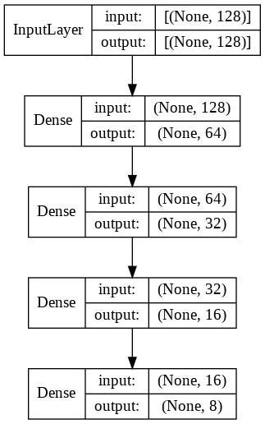
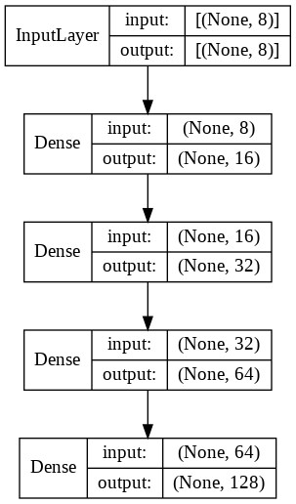
Compression Tecnique
Autoencoder

Slide 6
Training and Test setup
MSE for the train
Train: 0.00190
Test: 0.00189
Performed the matching using the constrain: d1<0.75d2
 | Original | Compressed | Reconstructed
Castel-P19 | 184.74s | 64.43s | 184.70s
Castle-P30 | 502.17 | 174.22s | 494.17s
Fountain-P11 | 103.71s | 36.37s | 105.52s

Slide 7
Results
 |  | Original | Compressed | Reconstructed
Castle-P19 | Points | 10583 | 7182 | 7959
 | Mean Track Lenght | 3.8402 | 3.2277 | 3.3563
 | Mean Reprojection error | 0.4535 | 0.4570 | 0.4738
Castle-P30 | Points | 19979 | 16752 | 17552
 | Mean Track Lenght | 4.8122 | 3.8404 | 4.0423
 | Mean Reprojection error | 0.4767 | 0.4722 | 0.4782
Fountain-P11 | Points | 10585 | 5327 | 6452
 | Mean Track Lenght | 4.7864 | 3.8136 | 4.0116
 | Mean Reprojection error | 0.3552 | 0.2583 | 0.2675

Slide 8
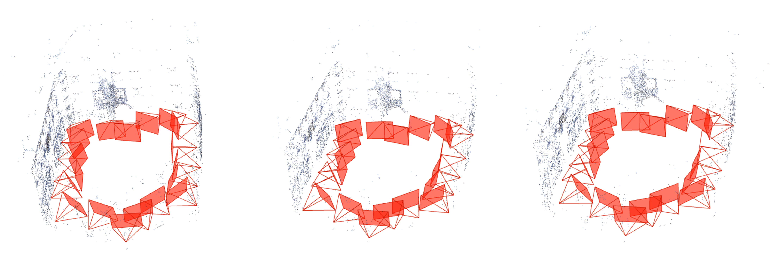
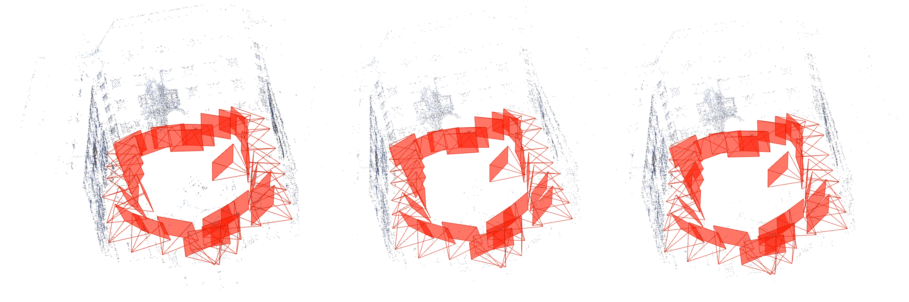
Original
Compressed
Reconstructed
Castle-P19
Castle-P30

Slide 9
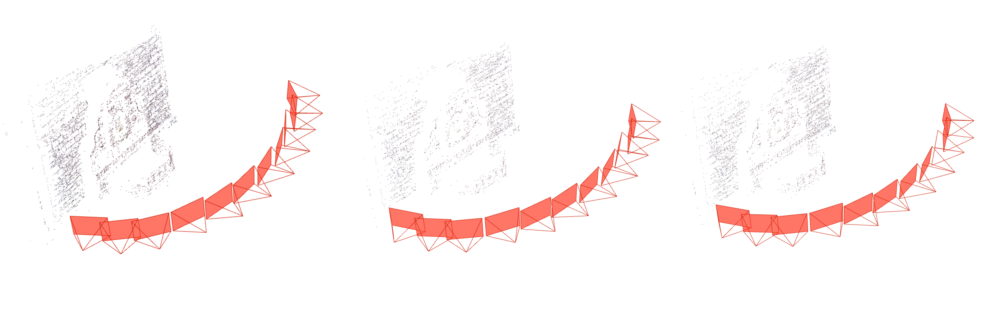
Original
Compressed
Reconstructed
Fountain-P11

Slide 10
Thank you for your attention.

